Slide 1
Concurrent Code Spread Spectrum:
Theory and Performance Analysis of Jam Resistant Communication Without Shared Secrets
William Louis Bahn
Ph.D. Dissertation
Electrical Engineering
Department of Electrical and Computer Engineering
University of Colorado at Colorado Springs
2012

Slide 2


Made possible by….
Committee
Mark A. Wickert – Chair
Rodger E. Ziemer
Charlie Wang
C. Edward Chow
Xiaobo Zhou
Leemon C. Baird III
This work was sponsored, in part, by the 688th Information Operations Wing (IOW), Lackland AFB, TX, and was performed at the Academy Center for Cyberspace Research (ACCR) at the United States Air Force Academy.
This material is based on research sponsored by the United States Air Force Academy under agreement number FA7000-10-2-0043. The U.S. Government is authorized to reproduce and distribute reprints for Governmental purposes notwithstanding any copyright notation thereon. The views and conclusions contained herein are those of the authors and should not be interpreted as necessarily representing the official policies or endorsements, either expressed or implied, of the United States Air Force Academy or the United States Government.

Slide 3
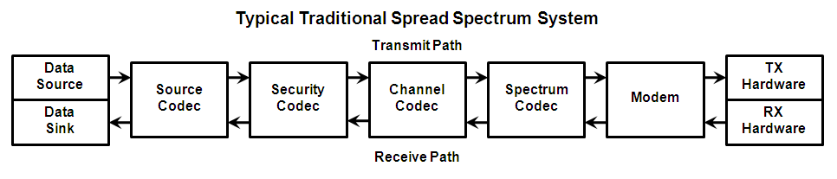
A typical spread spectrum system uses a spreading code to achieve jam resistance
Source Codec – Reduces information redundancy
Security Codec – Provides confidentiality, integrity, and authentication
Channel Codec – Adds redundancy that permits channel noise to be mitigated
Spectrum Codec – Spread the signal’s bandwidth to effectively hide it
The spreading code defines a channel independent of the message.
An attacker must know the spreading code to find the channel.

Slide 4
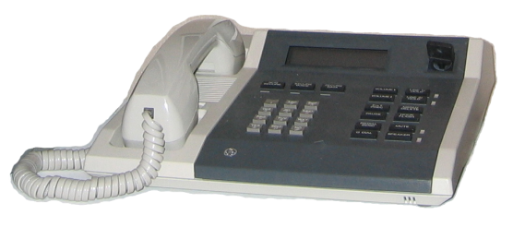
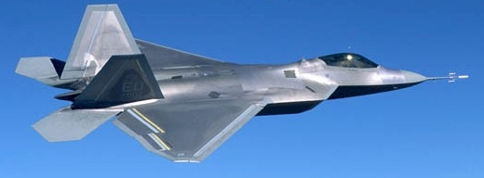
We Have a Key Management Problem
Example: STU
Examples: Have Quick, SINCGARS
  Occasional keying
  Different key for everyone
  Usually works
  Daily keying
  Same key for everyone
  Often fails

Slide 5

A Public Key Infrastructure (PKI) can provide confidentiality, integrity, and authentication.
Encrypt
COMSEC Keys
Decrypt
PKI-based
Asymmetric Keys
Sign
Check Signature
Common
Carrier
Common Carrier

Slide 6
Tactical Comms such as Have Quick and SINCGARS
Encrypt
COMSEC Keys
Decrypt
Sign
Check Signature
Symmetric Keys
TRANSEC Keys
Spread
Spectrum
Spread
Spectrum
Symmetric Keys

Slide 7
Applying PKI to Tactical Comms
Encrypt
COMSEC Keys
Decrypt
PKI-based
Asymmetric Keys
Sign
Check Signature
TRANSEC Keys
Spread
Spectrum
Spread
Spectrum
Symmetric Keys

Slide 8
But what if we had KEYLESS Jam Resistance?
Encrypt
COMSEC Keys
Decrypt
PKI-based
Asymmetric Keys
Sign
Check Signature
Spread
Spectrum
Spread
Spectrum

Slide 9
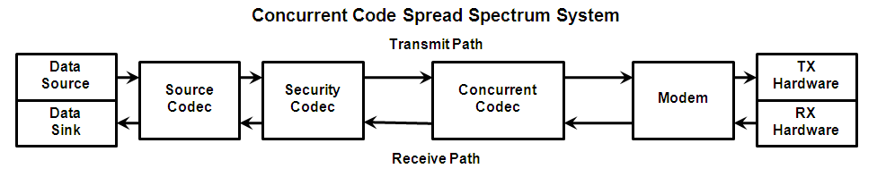
A concurrent codec combines channel coding and spectrum spreading
The spreading code defines a channel that depends on the message.
An attacker must know the spreading code and the message to find the channel.
The receiver must merely detect that a message’s channel is in use.
Asymmetric channels make suppressing channel activity very difficult.

Slide 10
What challenges face Keyless Jam Resistance?

Slide 11
The optimal jamming signal is another valid signal
With no key, jammer can transmit valid signals.

Slide 12
The optimal jamming signal is another valid signal
With no key, jammer can transmit valid signals.
We must assume they can align with legitimate signal.

Slide 13
The optimal jamming signal is another valid signal
With no key, jammer can transmit valid signals.
We must assume they can align with legitimate signal.
Causes extreme difficulty for receivers, which can’t decide which valid signal is the legitimate one.

Slide 14
The optimal jamming signal is another valid signal
With no key, jammer can transmit valid signals.
We must assume they can align with legitimate signal.
Causes extreme difficulty for receivers, which can’t decide which valid signal is the legitimate one.
In traditional systems, two valid signals of similar power make recovery of either impossible.

Slide 15
The optimal jamming signal is another valid signal
With no key, jammer can transmit valid signals.
We must assume they can align with legitimate signal.
Causes extreme difficulty for receivers, which can’t decide which valid signal is the legitimate one.
In traditional systems, two valid signals of similar power make recovery of either impossible.
Conventional wisdom: Secrets are necessary!

Slide 16
The optimal jamming signal is another valid signal
With no key, jammer can transmit valid signals.
We must assume they can align with legitimate signal.
Causes extreme difficulty for receivers, which can’t decide which valid signal is the legitimate one.
In traditional systems, two valid signals of similar power make recovery of either impossible.
Conventional wisdom: Secrets are necessary!
Unconventional wisdom: Don’t be so traditional!

Slide 17
KEYLESS spread spectrum:
So how is it possible?

Slide 18
There are two intertwined aspects of
Keyless Jam Resistance
Encoding/Decoding
Transmitting/Receiving

Slide 19
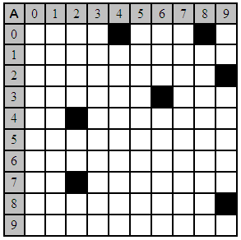
Let’s build a toy system…
Codeword for Message A →

Slide 20
Let’s build a toy system…
Codeword for Message A →
Message space – 32 messages.

Slide 21
Let’s build a toy system…
Codeword for Message A →
Message space – 32 messages.
Each codeword is 7 marks.

Slide 22
Let’s build a toy system…
Codeword for Message A →
Message space – 32 messages.
Each codeword is 7 marks.
100 possible mark locations.

Slide 23
Let’s build a toy system…
Codeword for Message A →
Message space – 32 messages.
Each codeword is 7 marks.
100 possible mark locations.
Code space – 16 billion codes.

Slide 24
Let’s build a toy system…
Codeword for Message A →
Message space – 32 messages.
Each codeword is 7 marks.
100 possible mark locations.
Code space – 16 billion codes.
Message is contained in the signal only if ALL marks associated with that message are present.

Slide 25
Let’s build a toy system…
Codeword for Message A →
Message space – 32 messages.
Each codeword is 7 marks.
100 possible mark locations.
Code space – 16 billion codes.
Message is contained in the signal only if ALL marks associated with that message are present.
Signal may contain multiple overlaid messages.

Slide 26
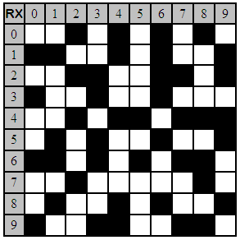
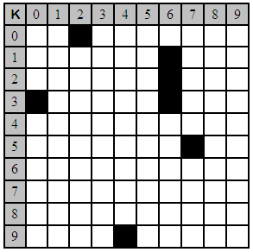
Which, if either, is present?

Slide 27
Which, if either, is present?

Slide 28
Which, if either, is present?

Slide 29
Which, if either, is present?
‘A’ is present

Slide 30
Which, if either, is present?
‘A’ is present

Slide 31
Which, if either, is present?
‘A’ is present

Slide 32
Which, if either, is present?
‘A’ is present
‘K’ is absent

Slide 33
Which, if either, is present?
‘A’ is present
‘K’ is absent
Are any others present?

Slide 34
Decoding is different than performing a membership test
Membership test: Is a given message present?
Signal decode: List all messages that are present.

Slide 35
What if a superimposed code is used?
Message is passed through n hash functions, each producing one of the n mark locations.
Each message consists of an independent set of marks.
With superimposed codes:
  Membership tests are easy.
  Decodes are difficult (usually requiring exhaustive search)

Slide 36
Concurrent Codes
Superimposed codes that can be efficiently decoded.
Each of the n possible message prefixes are passed through the same hash function.
Message codewords are not independent.
With concurrent codes:
  Membership tests are easy.
  Decodes are easy (performed in linear time)

Slide 37
Let’s build a codeword
Codeword for Message K →
Message: 0101000
  Hash(0) = 36
  Hash(01) = 57
  Hash(010) = 16
  Hash(0101) = 2
  Hash(01010) = 26
  Hash(010100) = 30
  Hash(0101000) = 94

Slide 38
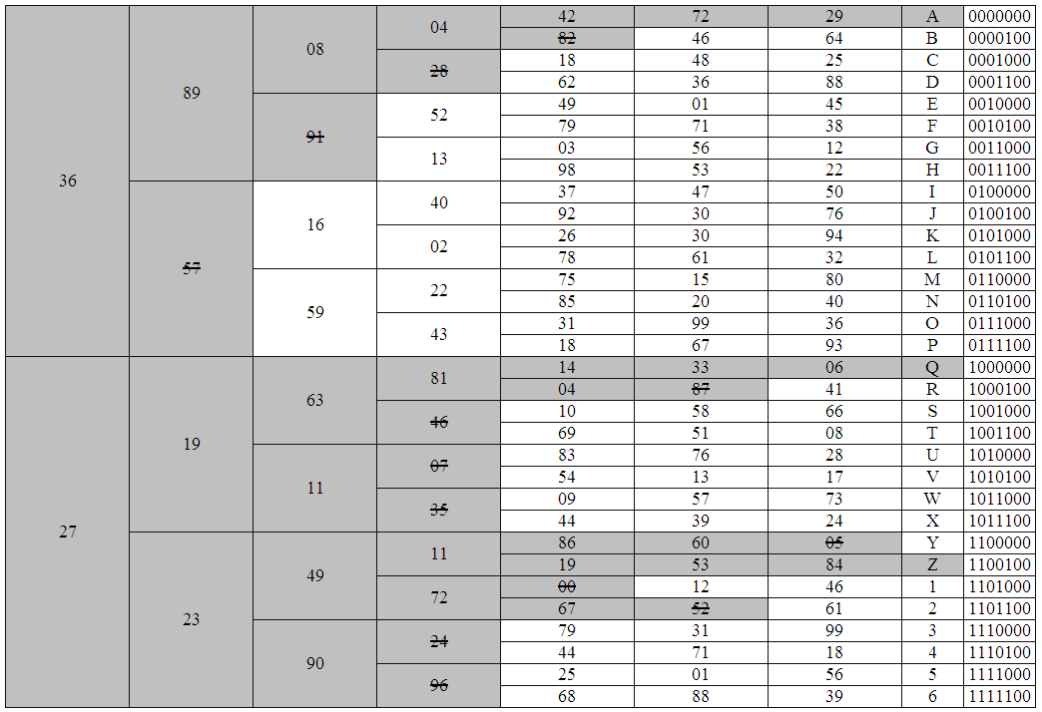
The decode tree for our signal packet:
{A,Q,Z} are the messages contained.

Slide 39
You now know Standard BBC!

Slide 40
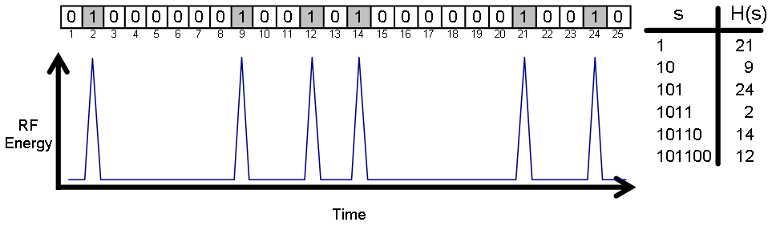
Standard BBC: Encoding is easy
Append K zero bits to the end of an L-bit message.
Run each of the (L+K) prefixes through a hash function.
Use each hash output to place a mark in the codeword.

Slide 41
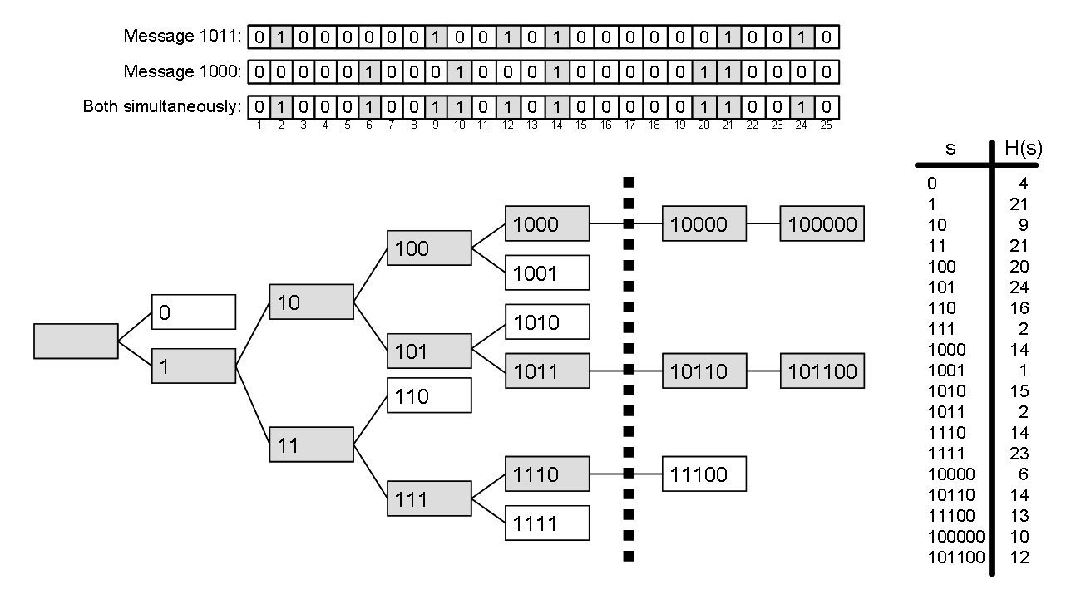
Standard BBC: Decoding is fast

Slide 42
Typical BBC parameters used to date provide good flexibility.
Thousand bit messages (L=2¹⁰)
Million bit codewords (C=2²⁰)
Thirty bit checksum (K=2⁵)
33% mark density threshold

Slide 43
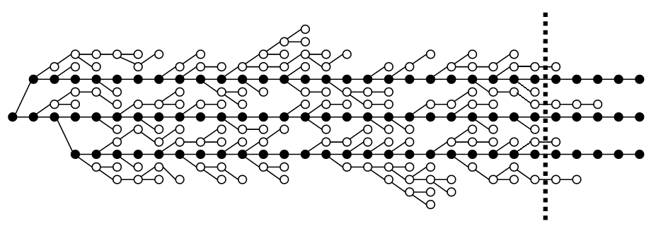
Decode trees typically have many short-lived false branches.

Slide 44
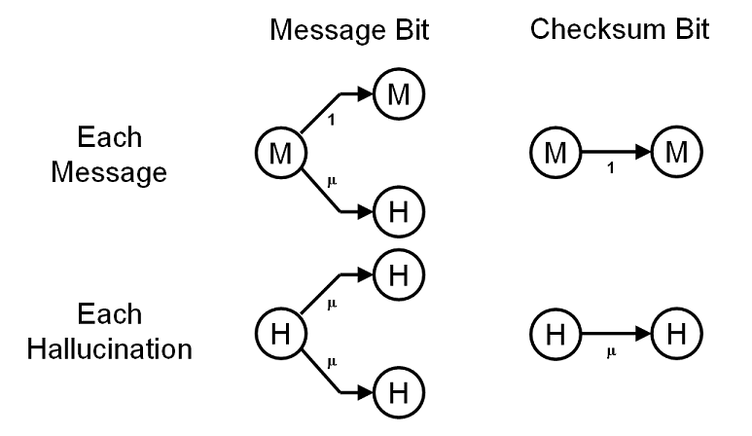
The performance is controlled by the time spent hallucinating.

Slide 45
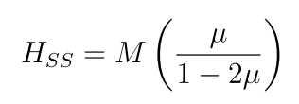
Packet densities <50% are fine
If denominator goes to zero …. That’s BAD!
  Critical Density: μ_{C} = 50%
If μ = 33%
  One hallucination per valid message

Slide 46
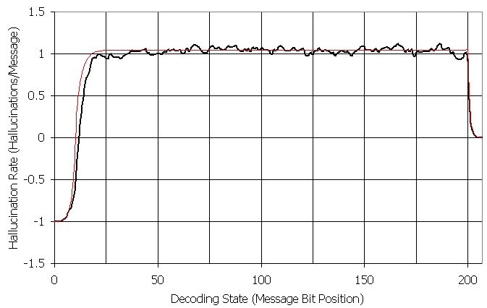
Performance matches theory
M = 1000 messages
L = 200-bit messages
K = 8-bit checksums
C = 512k-bit codeword
μ_{P} = 33.8% density
σ²_{H} = M
σ_{HR} = 1/sqrt(M)

Slide 47
We can enhance BBC three ways
Interstitial Checksum Bits
  Arbitrarily high critical density.
  Smaller hallucinogenic load.
Multi-bit BBC (M-ary BBC)
  Can improve coding and bandwidth efficiency
Multi-mark BBC
  Can tolerate missed marks
BUT NOTHING COMES FOR FREE!

Slide 48
Some combination of multi-mark and interstitials will likely prove most useful
Interstitial checksum bits (useful in small doses)
  More bits > more marks > higher density
  Codeword density grows faster than critical density
  Lower hallucination load can lead to faster decodes
Multi-bit (M-ary) (probably not useful)
  Critical density proportional to (1/2)^{B}
  Decoding burden proportional to 2^{B}/B
Multi-mark (probably useful)
  Allows occasional mark errors to be tolerated
  Example: 2-of-3 multimark can tolerate 180xPLR

Slide 49
Does it really work?

Slide 50
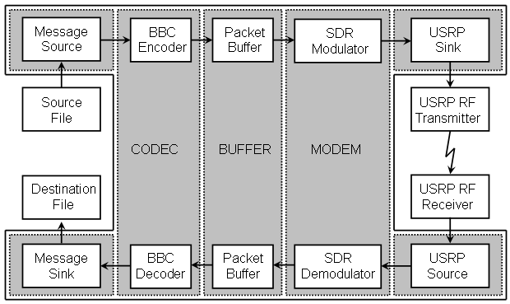
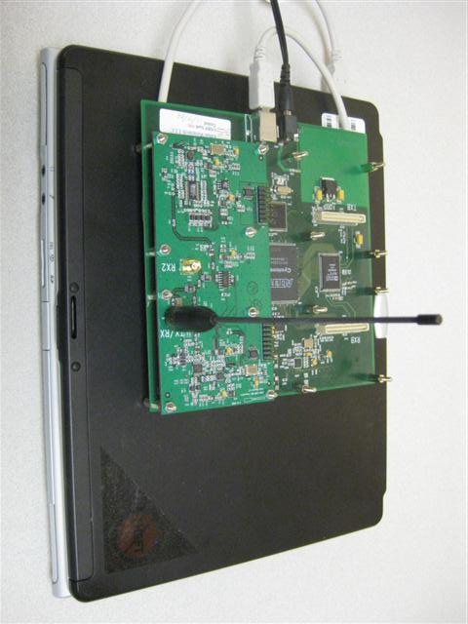
RF demonstrator based on Ettus USRP software-defined radio

Slide 51
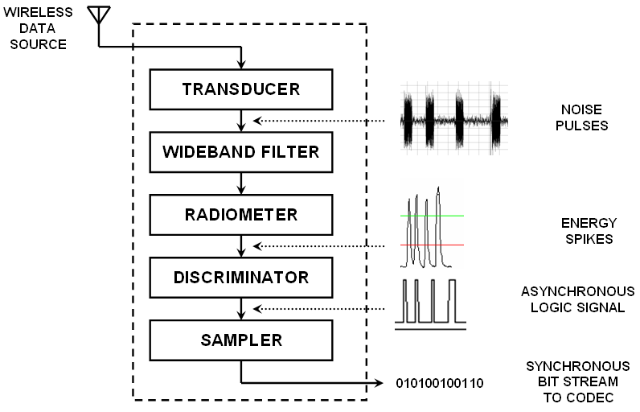
Simple receiver leaves little for attacker to attack
LNA

Slide 52
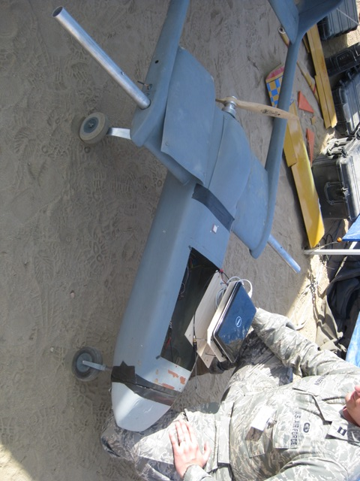
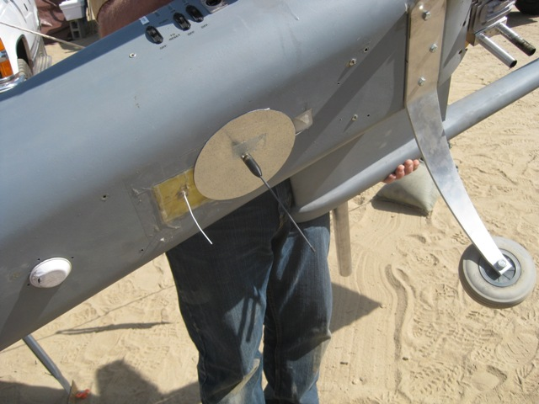
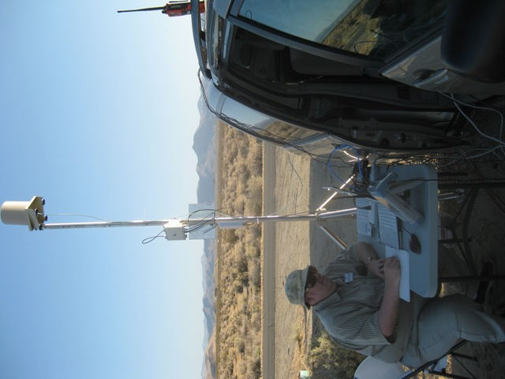

NAWS China Lake – Fun in the Sun!

Slide 53
Is it really Jam Resistant?

Slide 54
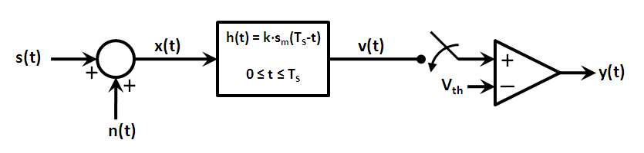
The analyzed receiver used a typical matched-filter detector

Slide 55
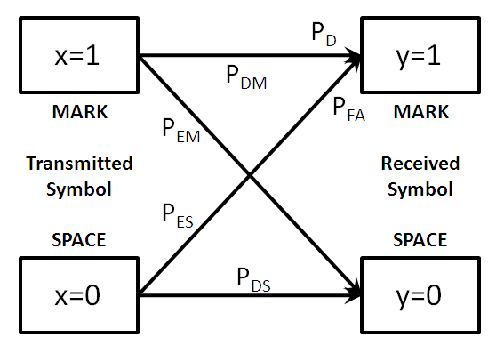
The same translation paths exist, but radar terminology convenient

Slide 56
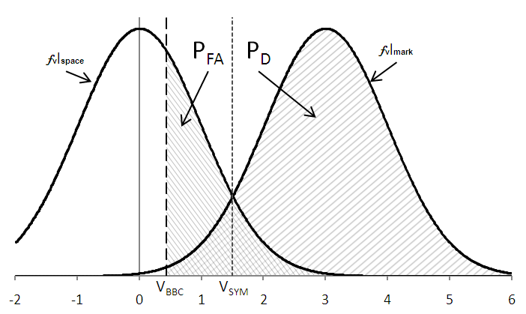
The BIG difference:
Threshold set well into the noise

Slide 57
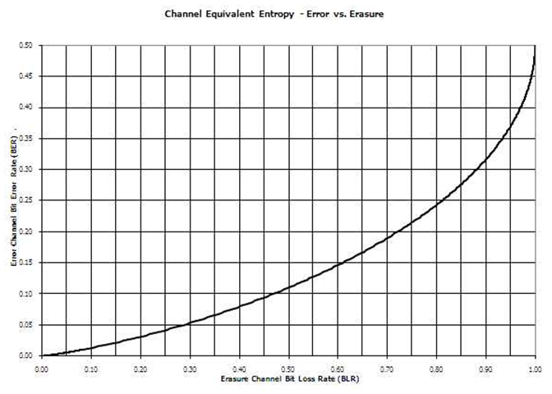
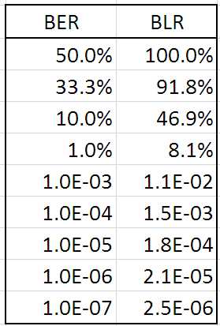
Concurrent codes create erasure channels, not error channels

Slide 58
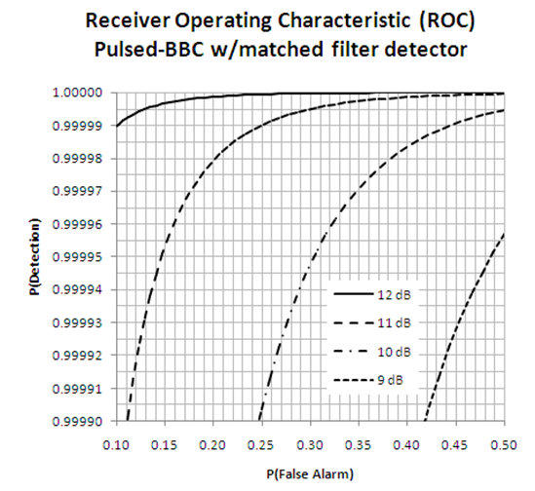
BER of 1% achieved with
P_{FA} = 33% & SNR/bit = 9.6 dB
P_{D} = (1-PLR)^{1/N}
N=1032-mark packets
BER = 1%
PLR = 8.1%
P_{D} = 0.99992
P_{FA}=33%
SNR/bit = 9.6 dB

Slide 59
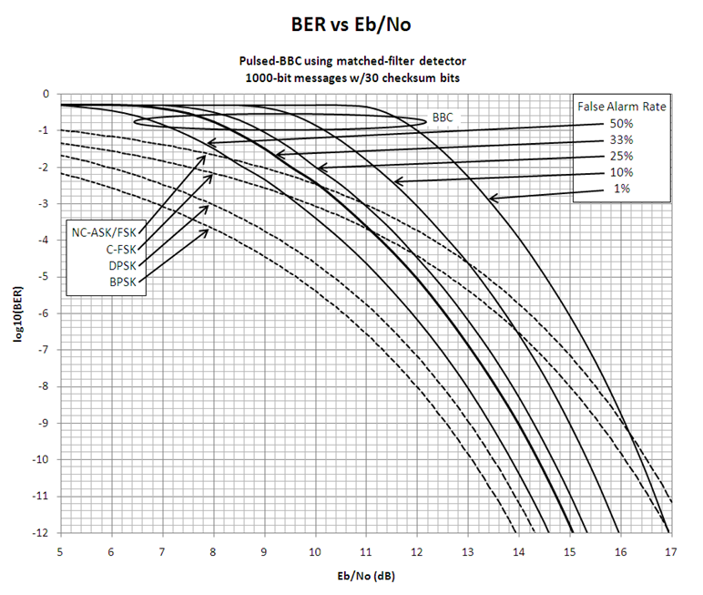
CCSS performs between FSK and PSK (SNR/bit > 11dB)

Slide 60
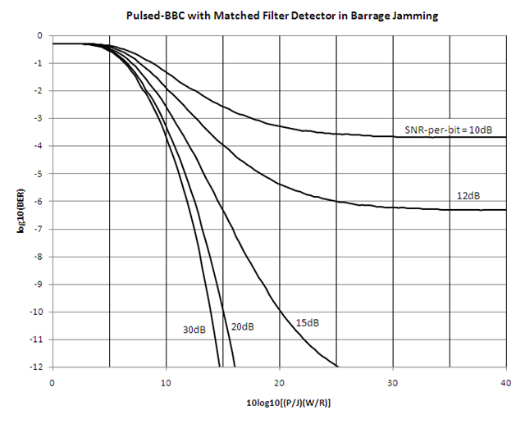
SNR/bit >~20dB realizes near-optimal performance

Slide 61
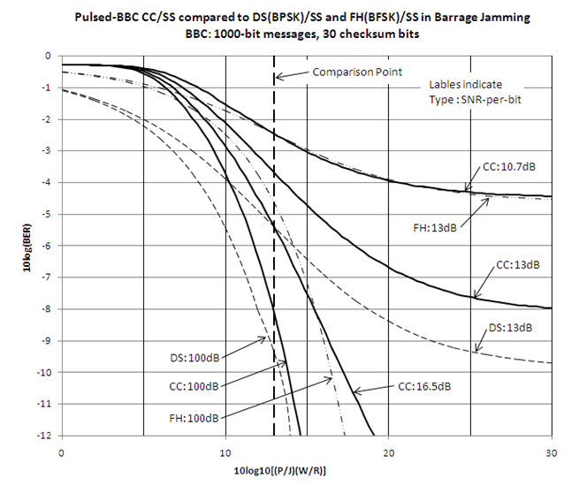
CCSS performs better than FHSS but not as well as DSSS

Slide 62
Where can we go from here?
RF performance analysis
  Mark waveforms (e.g., LFM chirps, Golay sequence)
  Detector options (e.g., radiometer, Golay correlator )
  Asynchronous issues (e.g., symbol alignment)
  Optimal waveform jamming (e.g., mark erasure, packet construction)
Comparison with other forms as an unreliable erasure channel
RF implementations of the various waveform/detector combos
FPGA/ASIC implementations of radios and/or building blocks
MAC-less protocol development
Other application areas (e.g., RFID, SINCGARS Fill Device)
Other questions (e.g., performance guarantees, non-BBC codes)

Slide 63
What was done and what I did
Concurrent codes are a notable extension to superimposed codes
  Efficient decoding is something that has not existed
  Potentially opens door to many previously ill-suited applications
Concurrent code spread spectrum offers new capabilities
  Comparable jam resistance without shared secrets
  Potentially simpler MAC-layer protocols (or even MAC-less protocols)
My contributions
  I was the primary contributor for:
    RF hardware , software, or analysis
    Interstitial checksum bits and multi-mark
    Oscillator mismatch and jitter compensation
  I was heavily involved in the collaboration on most other aspects
  I contributed least to the “hard core” theoretical/mathematical aspects

Slide 64
Peer Reviewed Publications (1/2)
L. C. Baird, III, M. C. Carlisle, and W. L. Bahn, “Unkeyed jam resistance 300 times faster: The Inchworm hash,” in Proc. 2010 IEEE Military Communications Conference (MILCOM10), Nov. 2010, p. CD.
L. C. Baird, III, D. L. Schweitzer, W. L. Bahn, and S. Sambasivam, “A novel "Visual Cryptography" coding system for jam resistant communications,” Journal of Issues in Informing Science and Information Technology, vol. 7, pp. 495--507, 2010.
W. L. Bahn, L. C. Baird, III, and M. D. Collins, “Oscillator mismatch and jitter compensation in concurrent codecs,” in Proc. 2008 IEEE Military Communications Conference (MILCOM08), Nov. 2008, p. CD.
W. L. Bahn, L. C. Baird, III, and M. D. Collins, “Jam-resistant communications without shared secrets,” in Proc. 3rd International Conference on Information Warfare and Security (ICIW08), Apr. 2008, p. CD.

Slide 65
Peer Reviewed Publications (2/2)
W. L. Bahn, L. C. Baird, III, and M. D. Collins, “The use of concurrent codes in computer and digital signal processing education,” Journal of Computing Sciences in Colleges, vol. 23, no. 1, pp. 174{180, Oct. 2007.
D. L. Schweitzer, L. C. Baird, III, and W. L. Bahn, “Visually understanding jam resistant communication,” in Proc. 3rd Intl. Workshop on Visualization for Computer Security (VizSec), Oct. 2007.
W. L. Bahn, L. C. Baird, III, and M. D. Collins, “Impediments to systems thinking: Communities separated by a common language,” in Proc. 4th Intl. Conf. on Cybernetics, Information Technologies, Systems and Applications (CITSA), vol. III, Jul. 2007, pp. 122--127.
L. C. Baird, III, W. L. Bahn, M. D. Collins, M. C. Carlisle, and S. C. Butler, “Keyless jam resistance,” in Proc. 8th Annual IEEE SMC Information Assurance Workshop (IAW), Jun. 2007, pp. 143—150.

Slide 66
USAFA Technical Reports (1/2)
W. L. Bahn, “A field demonstration of unkeyed jam resistance,” United States Air Force Academy, Academy Center for Cyberspace Research, Tech. Rep. USAFA-TR-2010-ACCR-04, Dec. 2010.
L. C. Baird, III and W. L. Bahn, “Parallel BBC decoding with little interprocess communication,” United States Air Force Academy, Academy Center for Cyberspace Research, Tech. Rep. USAFA-TR-2009-ACCR-01, Nov. 2009.
L. C. Baird, III and W. L. Bahn, “An O(log n) running median or running statistic method, for use with BBC jam resistance,” United States Air Force Academy, Academy Center for Cyberspace Research, Tech. Rep. USAFA-TR-2008-ACCR-03, Nov. 2009.
L. C. Baird, III and W. L. Bahn, “An efficient correlator for implementations of BBC jam resistance,” United States Air Force Academy, Academy Center for Cyberspace Research, Tech. Rep. USAFA-TR-2008-ACCR-02, Nov. 2009.

Slide 67
USAFA Technical Reports (2/2)
W. L. Bahn and L. C. Baird, III, “Hardware-centric implementation considerations for BBC-based concurrent codecs,” United States Air Force Academy, Academy Center for Cyberspace Research, Tech. Rep. USAFA-TR-2008-ACCR-03, Dec. 2008.
W. L. Bahn and L. C. Baird, III, “Extending critical mark densities in concurrent codecs through the use of interstitial checksum bits,” United States Air Force Academy, Academy Center for Cyberspace Research, Tech. Rep. USAFA-TR-2008-ACCR-02, Dec. 2008.
L. C. Baird, III and W. L. Bahn, “Security analysis of BBC coding,” United States Air Force Academy, Academy Center for Cyberspace Research, Tech. Rep. USAFA-TR-2008-ACCR-01, Dec. 2008.
L. C. Baird, III, W. L. Bahn, and M. D. Collins, “Jam-resistant communication without shared secrets through the use of concurrent codes,” United States Air Force Academy, Academy Center for Information Security, Tech. Rep. USAFA-TR-2007-01, 2007

Slide 68
QUESTIONS?

Slide 69
For more details….
Spread Spectrum 101
Security Goals
Codeword Images
Codeword Audio
Direct Sequence
BBC Enhancements
Running Statistic
Glowworm
Miscellaneous

Slide 70
Spread spectrum 101

Slide 71
Narrowband communications work fine in an nice, friendly, ideal world.
Chan = 14
Chan = 14
NB

Slide 72
But they are easily jammed by any competing signal of similar power.
Chan = 14
Chan = 14
Chan = 14
NB

Slide 73
Spread spectrum provides protection against a competing signal.
SS

Slide 74
In Frequency Hop Spread Spectrum (FH/SS), Sender and Receiver change frequencies according to a schedule.
Time Chan
14
45
23
12
19
31
42
Time Chan
14
45
23
12
19
31
42
FH/SS

Slide 75
Jammer doesn’t know schedule, so… they jam random frequencies.
Time Chan
14
45
23
12
19
31
42
Time Chan
38, 27, 24
19, 26, 45
18, 33, 37
15, 25, 29
13, 28, 44
29, 31, 49
22, 30, 42
Time Chan
14
45
23
12
19
31
42
FH/SS

Slide 76
Frequency sequence exchanged using a “secure alternate channel.”
Time Chan
14
45
23
12
19
31
42
Time Chan
14
45
23
12
19
31
42

Slide 77
What if the alternate channel isn’t so secure?
Time Chan
14
45
23
12
19
31
42
Time Chan
14
45
23
12
19
31
42

Slide 78
A “protocol jammer” DOES know the schedule, so… they jam the right frequencies at the right times.
Time Chan
14
45
23
12
19
31
42
Time Chan
14
45
23
12
19
31
42
Time Chan
14
45
23
12
19
31
42
FH/SS

Slide 79
SECURITY GOALS

Slide 80
Secure communications is multifaceted
Confidentiality
Integrity
Security
Authenticity
Availability
Notes:
The term “secure communications” has four aspects that, to a large degree, can be examined independently.

Slide 81
Secure communications is multifaceted
Can the bad guys read my message?
Confidentiality
Integrity
Security
Authenticity
Availability
Notes:
The term “secure communications” has four aspects that, to a large degree, can be examined independently.

Slide 82
Secure communications is multifaceted
Can the bad guys read my message?
Can the bad guys change my message?
Confidentiality
Integrity
Security
Authenticity
Availability
Notes:
The term “secure communications” has four aspects that, to a large degree, can be examined independently.

Slide 83
Secure communications is multifaceted
Can the bad guys read my message?
Can the bad guys change my message?
Confidentiality
Integrity
Security
Authenticity
Availability
Can the bad guys forge my message?
Notes:
The term “secure communications” has four aspects that, to a large degree, can be examined independently.

Slide 84
Secure communications is multifaceted
Can the bad guys read my message?
Can the bad guys change my message?
Confidentiality
Integrity
Security
Authenticity
Availability
Can the bad guys forge my message?
Can the bad guys jam my message?
Notes:
The term “secure communications” has four aspects that, to a large degree, can be examined independently.

Slide 85
Each goal is achievable when the good guys share secrets that the bad guys don’t know.
Can the bad guys read my message?
Can the bad guys change my message?
Confidentiality
Integrity
Security
Authenticity
Availability
Can the bad guys forge my message?
Can the bad guys jam my message?
Notes:
The term “secure communications” has four aspects that, to a large degree, can be examined independently.

Slide 86
Each goal is achievable when the good guys share secrets that the bad guys don’t know.
Encryption using
symmetric cryptography
Can the bad guys change my message?
Confidentiality
Integrity
Security
Authenticity
Availability
Can the bad guys forge my message?
Can the bad guys jam my message?
Notes:
The term “secure communications” has four aspects that, to a large degree, can be examined independently.

Slide 87
Each goal is achievable when the good guys share secrets that the bad guys don’t know.
Encryption using
symmetric cryptography
Hash functions,
message digests
Confidentiality
Integrity
Security
Authenticity
Availability
Can the bad guys forge my message?
Can the bad guys jam my message?
Notes:
The term “secure communications” has four aspects that, to a large degree, can be examined independently.

Slide 88
Each goal is achievable when the good guys share secrets that the bad guys don’t know.
Encryption using
symmetric cryptography
Hash functions,
message digests
Confidentiality
Integrity
Security
Authenticity
Availability
Passwords, MACs
Can the bad guys jam my message?
Notes:
The term “secure communications” has four aspects that, to a large degree, can be examined independently.

Slide 89
Each goal is achievable when the good guys share secrets that the bad guys don’t know.
Encryption using
symmetric cryptography
Hash functions,
message digests
Confidentiality
Integrity
Security
Authenticity
Availability
Passwords, MACs
High directionality and/or spread spectrum
Notes:
The term “secure communications” has four aspects that, to a large degree, can be examined independently.

Slide 90
Each goal is achievable when the good guys share secrets that the bad guys don’t know.
Encryption using
symmetric cryptography
Hash functions,
message digests
Confidentiality
Integrity
Security
Authenticity
Availability
Passwords, MACs
High directionality and/or spread spectrum
Notes:
The term “secure communications” has four aspects that, to a large degree, can be examined independently.

Slide 91
If a shared secret is not available,
a hole emerges for omnidirectional links.
Encryption using
asymmetric cryptography
Hash functions,
message digests
Confidentiality
Integrity
Security
Authenticity
Availability
Passwords, MACs
High directionality and/or spread spectrum
Notes:
The term “secure communications” has four aspects that, to a large degree, can be examined independently.

Slide 92
If a shared secret is not available,
a hole emerges for omnidirectional links.
Encryption using
asymmetric cryptography
Digital Signatures
Confidentiality
Integrity
Security
Authenticity
Availability
Passwords, MACs
High directionality and/or spread spectrum
Notes:
The term “secure communications” has four aspects that, to a large degree, can be examined independently.

Slide 93
If a shared secret is not available,
a hole emerges for omnidirectional links.
Encryption using
asymmetric cryptography
Digital Signatures
Confidentiality
Integrity
Security
Authenticity
Availability
Digital Signatures
High directionality and/or spread spectrum
Notes:
The term “secure communications” has four aspects that, to a large degree, can be examined independently.

Slide 94
If a shared secret is not available,
a hole emerges for omnidirectional links.
Encryption using
asymmetric cryptography
Digital Signatures
Confidentiality
Integrity
Security
Authenticity
Availability
Digital Signatures
Omnidirectional SS
easily jammed
Notes:
The term “secure communications” has four aspects that, to a large degree, can be examined independently.

Slide 95
CONCURRENT CODES
Seeing is Believing

Slide 96
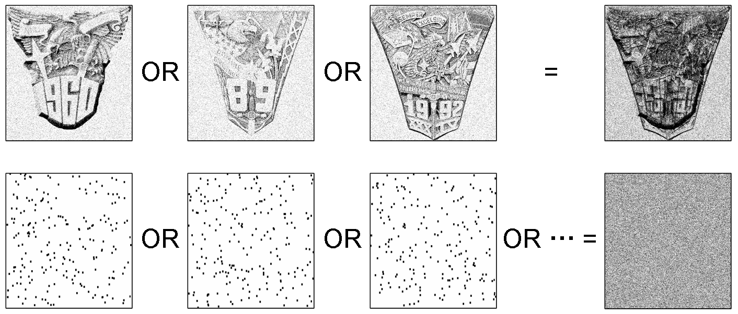

Slide 97

3 superimposed codewords

Slide 98
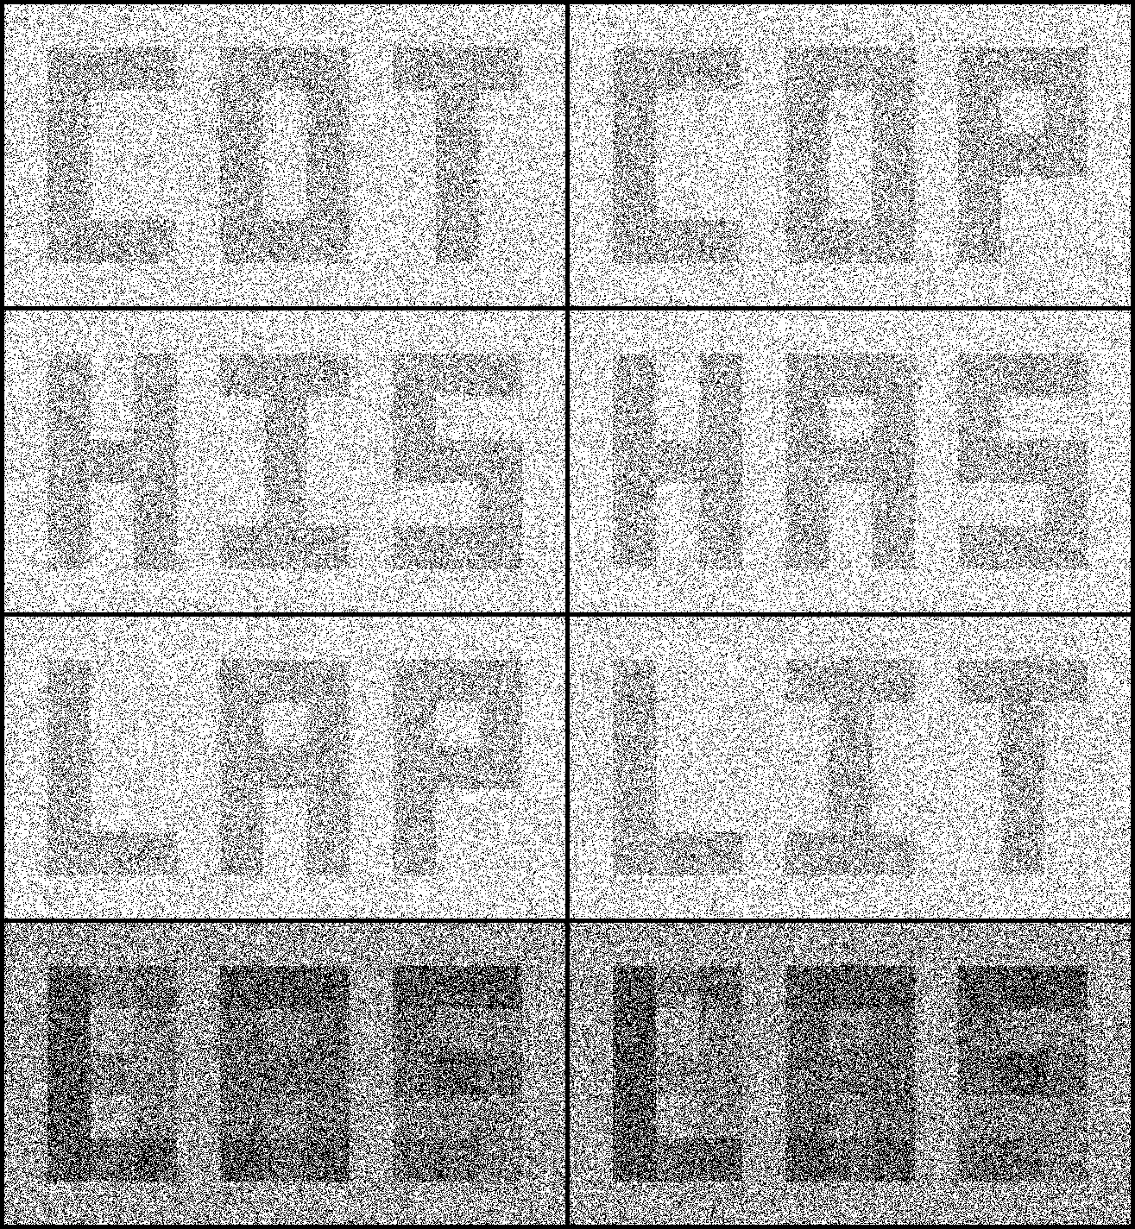

Slide 100

LENA – As you’ve never seen her!

Slide 101
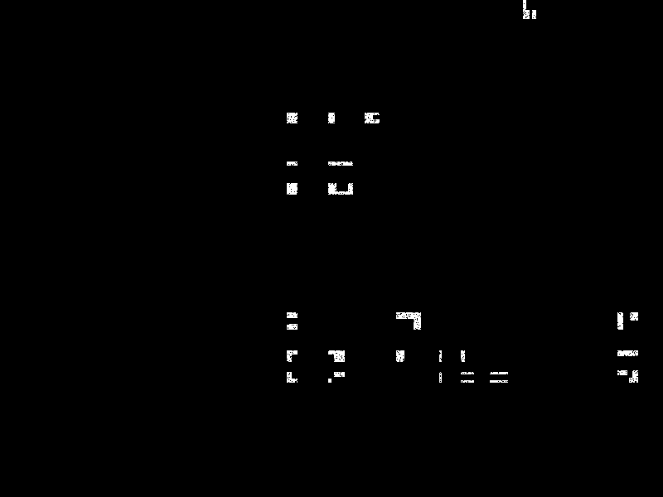
480-bit message; 480,000 bit codeword with 95.3% density – still decodable.

Slide 102
CONCURRENT CODES
You Heard it Right

Slide 103
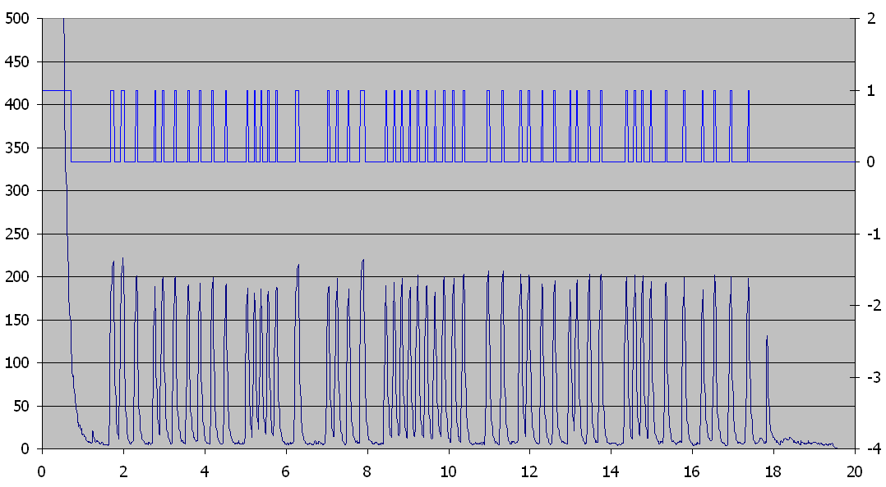

Slide 104
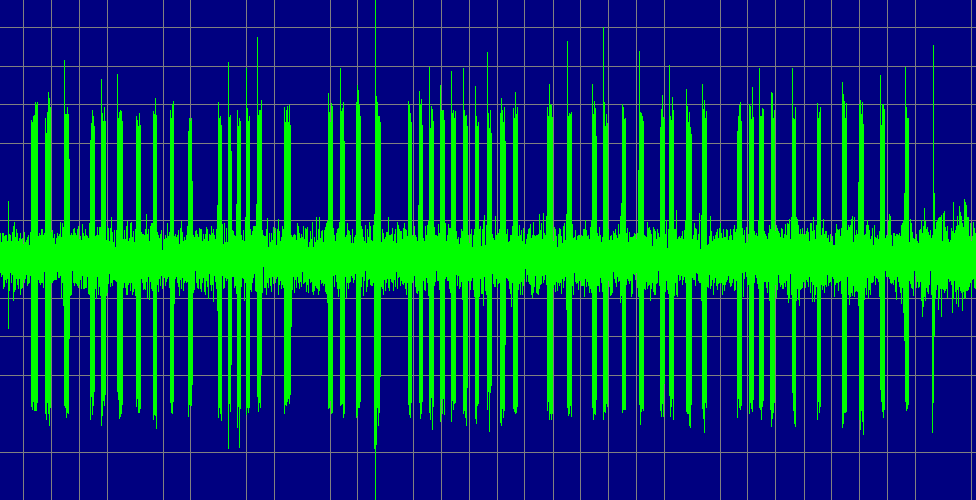

Slide 105
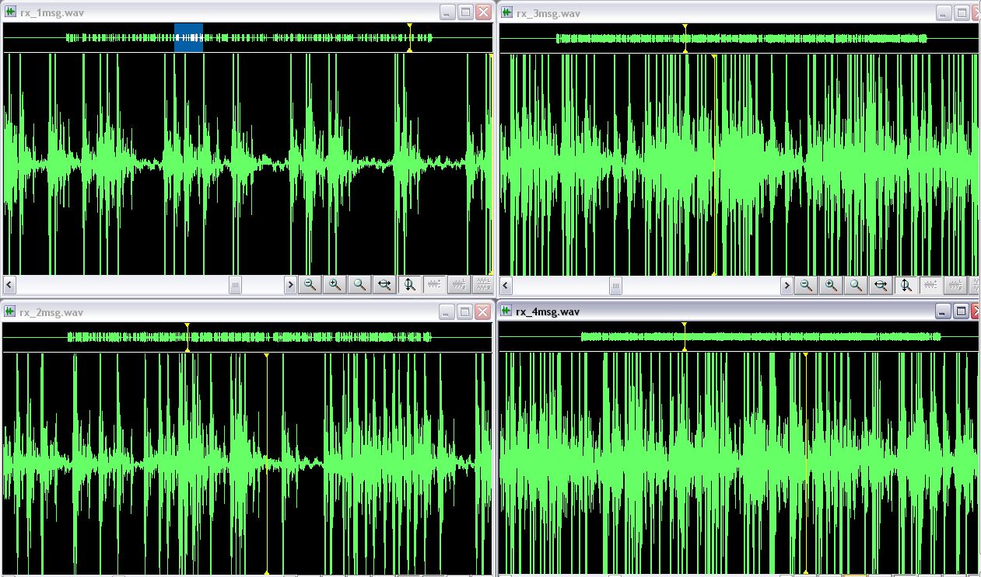

Slide 106
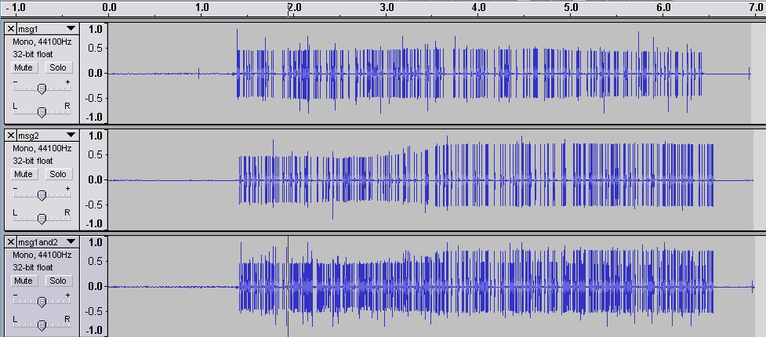

Slide 107
CONCURRENT CODES
Over Direct Sequence

Slide 108
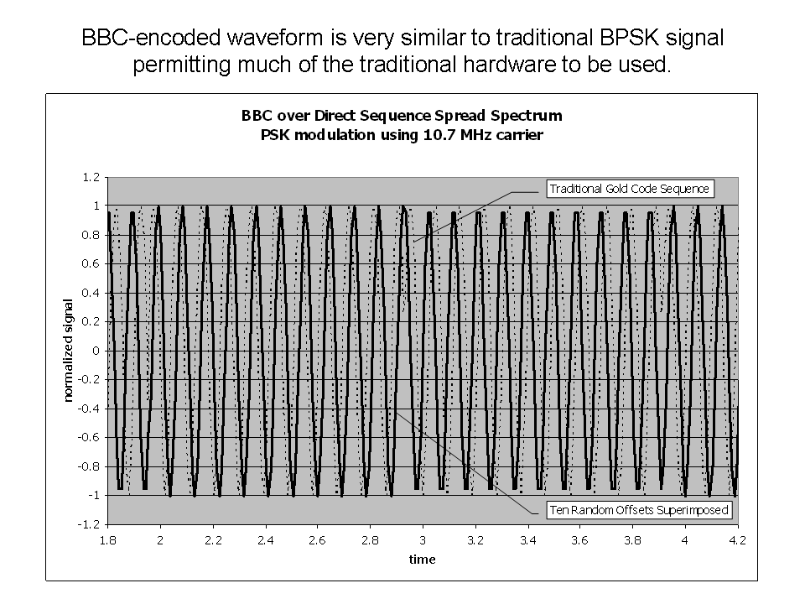

Slide 109
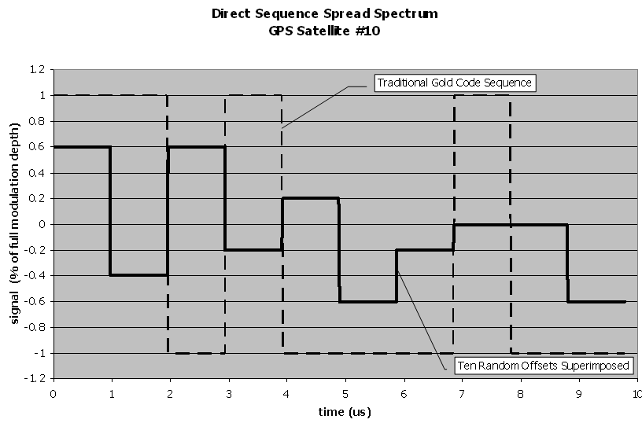

Slide 110
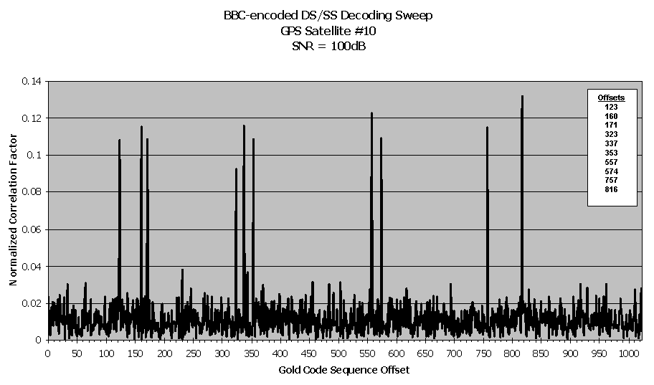

Slide 111
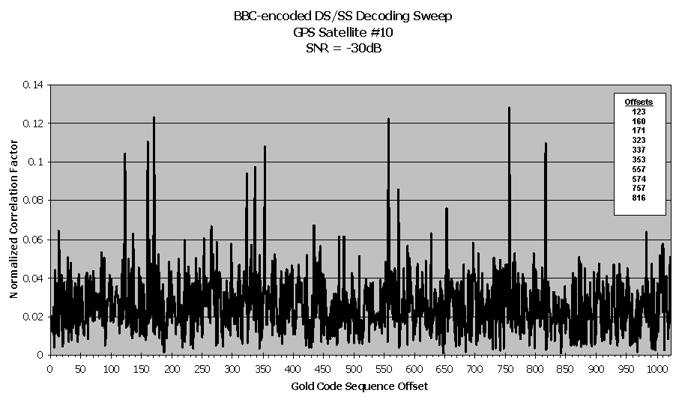

Slide 112
BBC Enchancements

Slide 113
Interstitials are fun, but of limited practicality
More bits > more marks > higher density
Codeword density grows faster than critical density
Lower hallucination load can lead to faster decodes

Slide 114
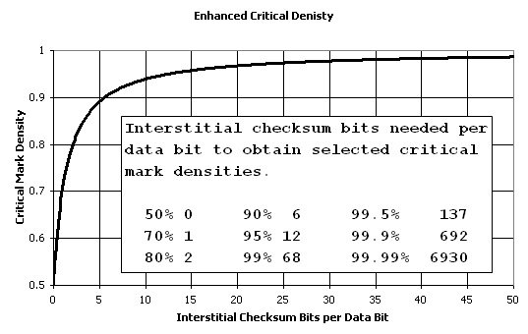
Very rapid improvement for first few interstitial checksum bits

Slide 115
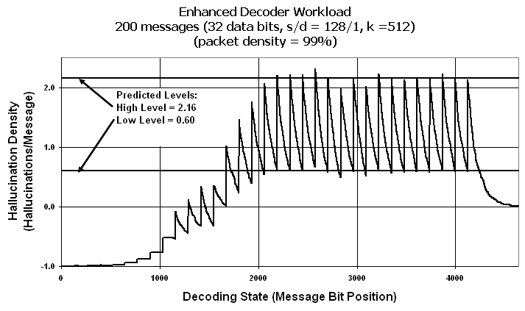
Very high density codewords can still decode efficiently

Slide 116
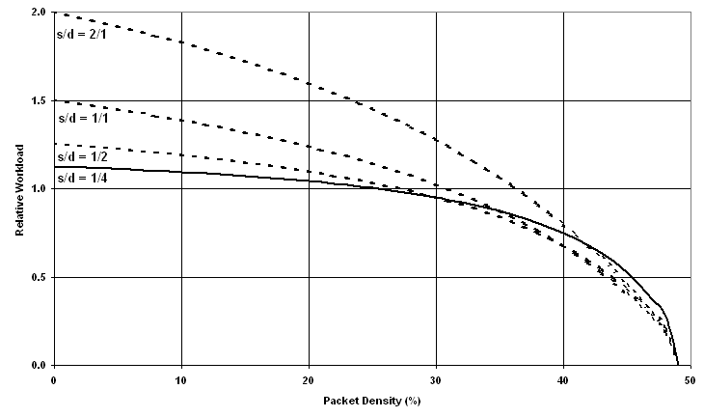
Mild use of interstitials can decrease absolute decode effort.

Slide 117
Multi-bit BBC is probably not useful
Nice parallel to M-ary modulation schemes
Critical density inversely proportional to block size
Decoding burden exponential with block size
Quadrature (2-bit/mark) may be useful

Slide 118
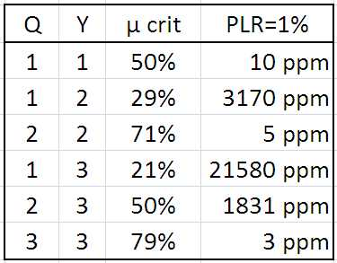
Q-of-Y Multi-mark BBC is probably useful

Slide 119
What about practical considerations?
Packet identification
  Place “Bookend Marks” in each packet
  Each received mark is treated as a potential packet start
Symbol timing
  Leverage intrinsic tolerance for space errors
  Leverage packet-level decoding to compensate
Threshold level
  Running statistic threshold forces optimal threshold
Hash function performance
  Use task-specific hash function (Glowworm)
Multipath
  Intrinsic tolerance – echoes are just additional messages

Slide 120
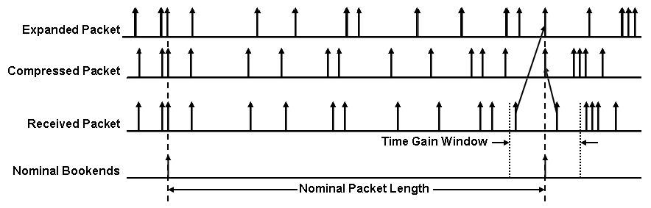
Bookend marks permit compensation for significant oscillator mismatch

Slide 121
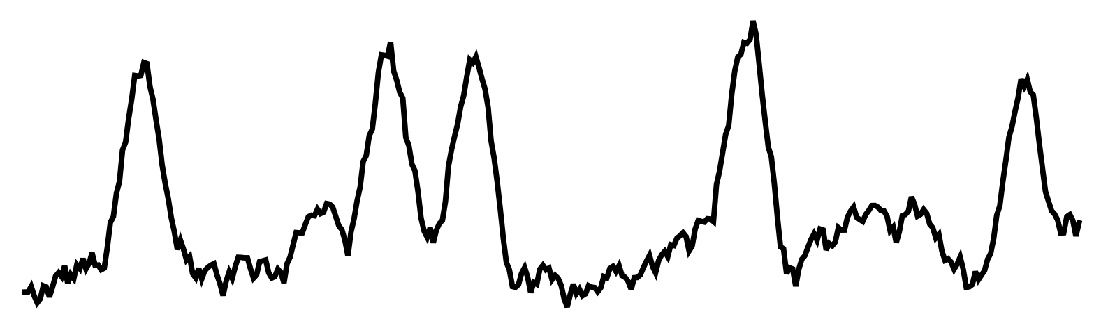
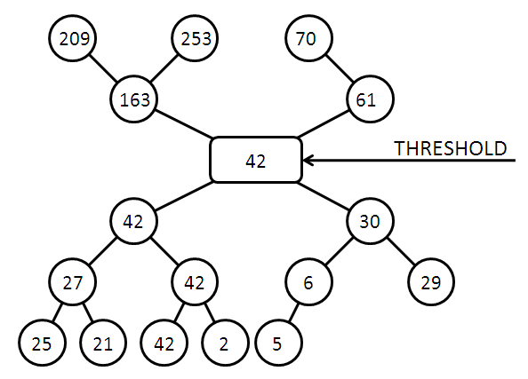
Running statistic threshold can set the best threshold for EACH packet.
Buffer
Packet
Log(n) time per packet!

Slide 122
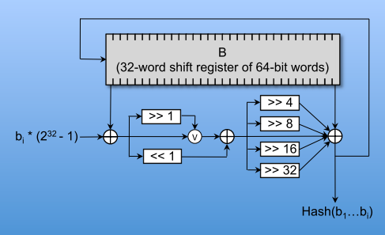
The Glowworm hash is structurally simple and efficient in both hardware and software

Slide 123
CONCURRENT CODES
This and That

Slide 124
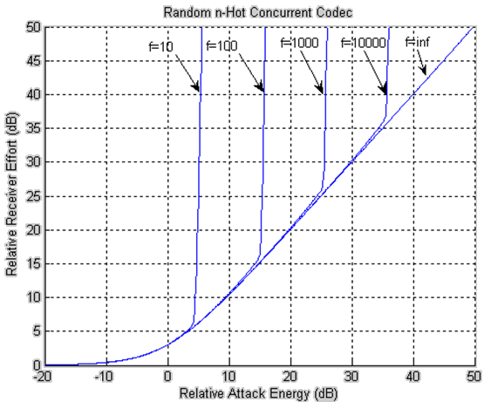

Slide 125
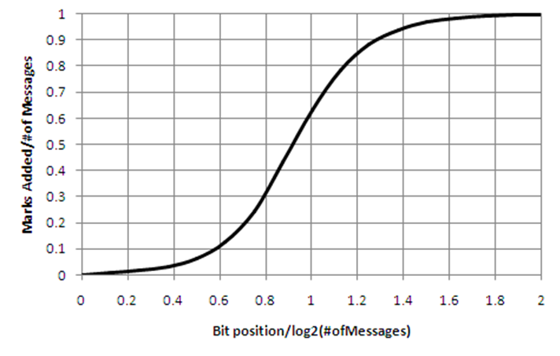

Slide 126


Slide 127
Efficient Golay Correlator
X
a₀
D₁
a₁
D₂
a₂
D₃
a₃
D₄
a₄
Y
b₀
+
b₁
+
b₂
+
b₃
-
-
-
-
-
-
W₁
W₂
W₃
W₄
Y’
a₀
a₁
a₂
a₃
a₄
X’
b₀
D₁
+
b₁
D₂
+
b₂
D₃
+
b₃
D₄
-
-
-
-
-
-
W₁
W₂
W₃
W₄

Slide 128

The complete codebook

Slide 129
KEYLESS spread spectrum:
What does it make possible?

Slide 130








Unkeyed Jam Resistance
Jam Resistant Communication
  Need jam resistance without a shared secret
  Needed for civilian GPS, RFID, radio nets
?
?

Slide 131
INTERMISSION:
Let’s see it in action!

Slide 132
What else remains to be done?

Slide 133
Research Projects
  Major projects
    Ad hoc networks – UAVs, power company, SCADA
    RFID
    GPS
  Low-level code – embedded chips, CUDA, hardware
  Networking simulations / code – ad hoc nets, new protocols
  RFID – experiment with programming our new hardware
  Exhaustive search – monotone functions, attacks on hashes
  Math questions – algorithm variants, monotone, graph coloring
  Hardware – design analog & digital circuits, FPGAs

